Slide 1
The Colonies
An English Adventure:

Slide 2
Jamestown
1. Jamestown was the first permanent colony established in the New World on May 6, 1607.
2. Difficulties
Starvation, disease, fights with Native Americans.

Slide 3
John Smith
1. He forced the colonists to shape up or ship out sort of speak.
2. Smith dealt with the Powhatan Confederacy—he was eventually captured by these Native Americans and released.

Slide 4
First Powhatan War
1. This war grew out of mistrust between the colonies and the Powhatans.
2. In August 1610, the colonists under the leadership of Captain George Perry surprised and attached a Powhatan village—killed 65 and burnt homes and fields.

Slide 5
First Powhatan War
3.After this raid, the colonists brutally killed the wife of the Indian chief of the village.
4. Colonists were also tortured for misbehaving.
5. Colonists capture the Chief Powhatan’s daughter Pocahontas in 1613.
She married John Rolfe, changed her name to Rebecca and became a Christian.
The Chief eventually gave in and ended the war.

Slide 6
Headright Policy
1.This policy allowed anyone who bought shares in the stock company and traveled to Virginia to receive fifty acres of land and fifty more per servant.
2. Developed by Sir Edward Sandys who became the head of the Virginia Company in 1618.

Slide 7
Tobacco
1. Tobacco was discovered by Christopher Columbus.
2. John Rolfe develops a new strand in 1612.
3. Indentured servants became a huge part of the tobacco industry.
Indentured servants were those whom New World masters paid for their trip in return for 4-7 yea

Slide 8
New England Colonies
1. Made up of middle class families.
2. Healthier region to live than the southern colonies.
3. The New England region was dominated by various religious groups—especially when compared to the South.

Slide 9
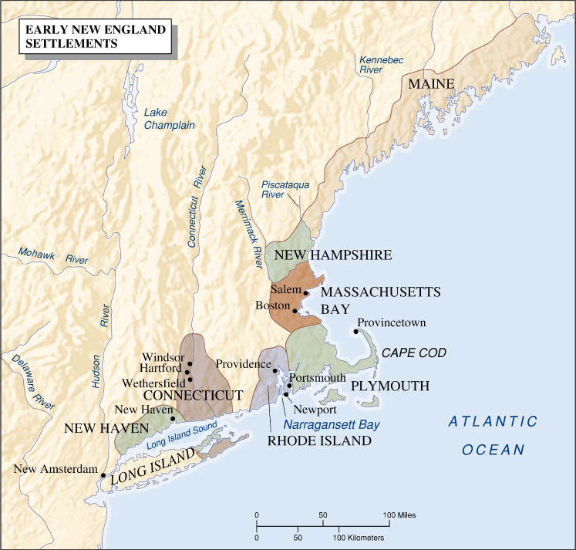
Early New England Settlements

Slide 10
Plymouth
1. People who settled here were known as Pilgrims.
2. The colony was established in 1620 under William Bradford.
3. Squanto, a Wampanoag Indian helped the colonists to survive the first year.
4. Mayflower Compact—colonist agreement to allow majority-rule government.

Slide 11
Anglicans, Puritans, and Quakers
1. Anglican church was the integration of Calvinism and Catholicism.
2. Puritans in the Americas wanted to create a model society committed to the proper worship of God.
3. Quakers originated in mid-seventeenth-century England under the direction of George Fox.

Slide 12
The Pequot War
1. First major conflict between colonists in New England and the Indians in the region began in 1636.
2. Conflict began as colonists attempted to control Indians by conquering the Mystic River Valley from the Pequot Indians.
Colonists demanded high tax from Indians to be paid in Wampum.
The colonists insisted on a large number of Pequot children serving as slaves.
Pequot tribal members suspected of killing local colonists were to surrender to the colonists.

Slide 13
The Pequot War
3. Narragansett and Mohegan Indians assist the colonists in the fight.
4. About half of the Pequot nation is killed in the war.
5. Ironically, in the next generation, the Pequot would assist the colonists in the fight against the Narragansett Indians.

Slide 14
King Phillip’s War
1. This was bloodiest Indian war in New England.
Killed one-quarter of the southern New England population.
2. Wampanoag Indians were led by Metacom (known to the colonists as King Phillip).

Slide 15
New Netherland—New York
1. Dutch gain independence from Spain.
2. Henry Hudson discovers Delaware Bay and the Hudson River in 1609.
3. New Amsterdam becomes the capital of New Netherland.
4.New Netherland becomes New York when James II invades and conquers the region in late 1660s.

Slide 16
Dutch Legacies in the New World
1. Wall Street
2. Broadway
3. Roosevelt

