Slide 1
Career and Technical Education
“It is an inescapable fact that our society is based on work. Those who are not equipped with the knowledge and skills necessary to get-and keep-good jobs are denied full social inclusion and tend to drop out of the mainstream culture, polity and economy.”
Anthony P. Carnevale
Research Professor and Director
The Georgetown University Center on Education and the Workforce
Notes:
Greyson V.- NHS

Slide 2
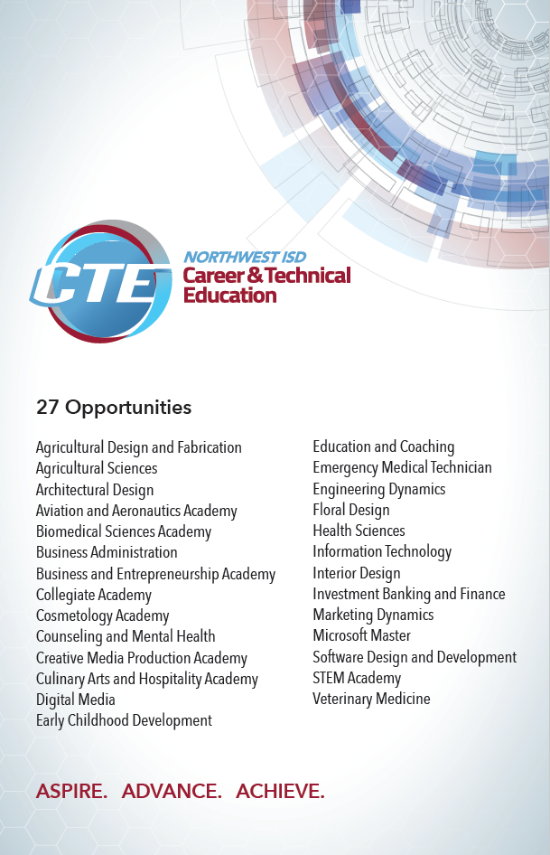
Requirements of a Pathway
Alignment with labor-market demand
Integration of rigorous core academics and career-focused learning
College and career information and advising
Links between secondary and postsecondary education
Credentials with value in the labor market
Continuum of work-based learning experiences
Cross-sector partnerships

Slide 3
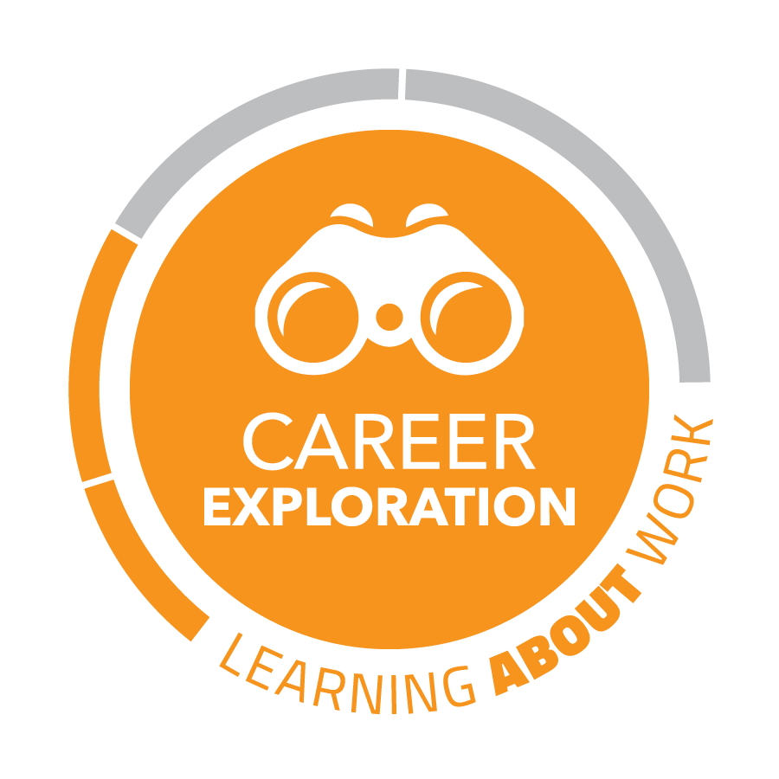
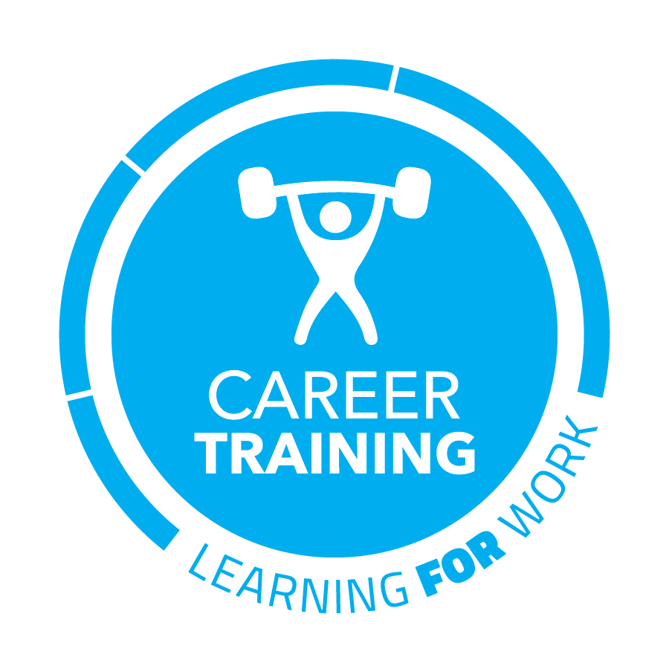
A good pathway guides a student from awareness
to training over a period of time.

Slide 4
Resources for Administrators
Texascte.org
CTAT Career and TechnicalAssociation of Texas
ACTE Association of Career and Technical Education
High Quality CTE 4.0- Most valuable resource out there
Read Learning For Careers
Read Answering Why By Mark Perna

Slide 5
Self-assessment for High Quality CTE
Work-Ready Industry Certifications
Strong Pathway Content Huddles
Post-Secondary Opportunities
Notes:
We’ve read about how too many young people today finish school lacking in both practical, marketable skills, as well as the professional skills needed to secure a job, collaborate on a team, make a presentation, and successfully navigate in the real workplace. NISD has made a commitment to state of the art equipment and educational environments that provide hands-on learning experiences that go beyond traditional factory model education. We are no longer focusing on the misconceptions that the only path to career success requires 4-6 years in a collegiate academic setting. We are focused on re-establishing the rich learning environments that provide experiential learning with a defined focused of being Skilled, Credentialed, & Ready for whatever path life takes our students.

Slide 6
Did you know CTE courses can count for Core academic credit?

Slide 7
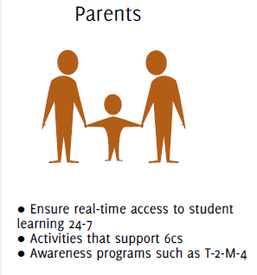
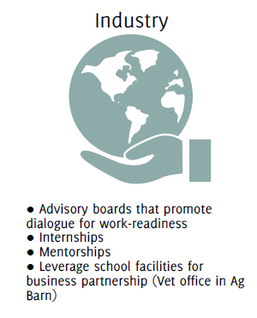
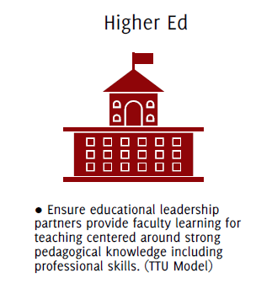
All CTE programs should operate around five domains of decision making

Slide 8
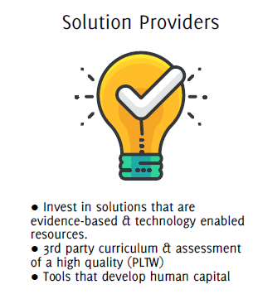
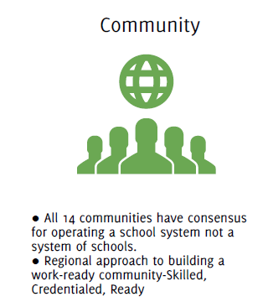

Slide 9
“The ultimate relevance of education is when it empowers people to do work in the world rather than retreat from it.”
Anthony P. Carnevale
Research Professor and Director
The Georgetown University Center on Education and the Workforce

