Slide 1
Effective Schools Framework (ESF) Introduction

Slide 2
Do you engage in continuous improvement efforts in these areas each year?
Strong School Leadership and Planning
Effective, Well-Supported Teachers
Positive School Culture
High-Quality Curricular Resources
Effective Instruction
Notes:
Raise your hand if you engage in continuous improvement efforts around these focus areas each year.

Slide 3
Common Best Practices
Develop campus instructional leaders (principal, assistant principal, teacher leaders) with clear roles and responsibilities
Recruit, select, assign, induct, and retain a full staff of highly qualified educators
Compelling and aligned vision, mission, goals, values focused on a safe environment and high expectations
Curriculum and assessments aligned to TEKS with a year-long scope and sequence
Objective-driven daily lesson plans with formative assessments
Data-driven instruction
Notes:
Keep your hand up if you, as district and campus leaders, have implemented at least one of these best practices?
Your feedback further validates and aligns with the work of over 250 stakeholders that were involved in the development of the Effective Schools Framework.
Let’s take a closer look at how it came about.

Slide 4
A Collaborative Partnership
TEA + ESCs
ESCs + Districts
Districts + Campuses
Notes:
Intro- Collaborative Effort and Embracing Continuous Improvement
Over the past two years we have had to opportunity to work much more closely with our ESCs and strengthen the relationships across the state in order to provide coordinated support to our LEAs.
The ESF is the outcome of a collaborative effort across various stakeholders to continue to support continuous improvement at the agency, in ESCs and in LEAs.
Engaged with more than 250 stakeholders through 15 different engagement sessions
Same Things (aligning on those practices that have the greatest impact on student performance)
To determine what those essential practices are that we should be talking about above all else, we gathered:
Feedback from educators on what are those crucial practices are
Research and evidence on what produce the greatest gains in student performance

Slide 5
Strategic and Sustainable Improvement
Feedback to TEA highlighted moves away from focusing on:
Products Practices
Quick fixes Long-term solutions
Isolated acts of Integrated strategy
improvement
Notes:
We have had other frameworks in place in the past and we needed to hear how well those have worked so we needed to ensure that we were asking the right questions.
How could we offer support the various continuous improvement efforts being implemented?
What worked in the past?
What lessons have we learned?
How could we move away from what was deemed a cumbersome process?
What would be responsive to LEA needs?
What we heard- Big Take-aways
Our needs assessment process was very insightful and not only captured the successes and lessons learned, but provided multiple stakeholder groups the opportunity to share their voice in what would be the MOST responsive to their needs.
Right Things (strategic and sustainable processes for improvement)
The field has told us – we want to change the dialogue to
practices not products
Integrated strategy instead of random acts of improvement
long-term solutions, not quick fixes

Slide 6
The Effective Schools Framework aims to address gaps in the previous state framework
From
Broad categories open to individual interpretation across stakeholders (LEAs, ESCs, PSPs, TEA)
Greater chance of schools not knowing where to start in their improvement paths
To
More focused and normed understanding of best practices
Guidance for schools toward effective prioritization
An emphasis on the district conditions necessary for campuses to succeed
An emphasis on the campus principal and the individual school
Notes:
More specifically- we had to address the gaps in previous approaches.
Highlight the changes on the slide

Slide 7
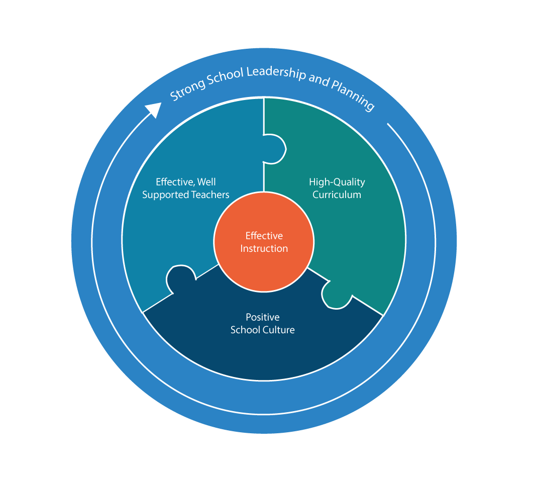
A Common Vision of School Best Practices
The levers work together as an integrated whole, centered around the instructional core.
Prioritized Levers > District Commitments > Essential Actions > Key Practices
Notes:
Few Things
Organization of the framework – graphic showing levers;
Indicate essential actions and parallel supports districts can provide around those actions
Not the entire universe of practices, but those that have the greatest ripple on producing great instruction and student learning
The foundational levers effective schools pull in order to ensure that students receive an excellent education
The levers work together as integrated whole, centered around the instructional core.
The ESF defines 5 Prioritized Levers that are essential in high performing campuses.
Each lever has Essential Actions that describe what the most effective schools do to support powerful teaching and learning.
There are 5 Foundational Essential Actions (one for each lever) that schools need to address first.
The framework also includes District Commitments organized by Lever that describe the conditions local education agencies must provide so that schools are set up for success

Slide 8
13 Essential Actions
Prioritized Lever 1: Strong School Leadership and Planning
Develop campus instructional leaders (principal, assistant principal, teacher leaders) with clear roles and responsibilities
Focused plan development and regular monitoring of implementation and outcomes
Prioritized Lever 2: Effective, Well-Supported Teachers
Recruit, select, assign, induct, and retain a full staff of highly qualified educators
Build teacher capacity through observation and feedback cycles
Prioritized Lever 3: Positive School Culture
Compelling and aligned vision, mission, goals, values focused on a safe environment and high expectations
Explicit behavioral expectations and management systems for students and staff
Proactive and responsive student support services
Involving families and community
Prioritized Lever 4: High-Quality Curricular Resources
Curriculum and interim assessments aligned to TEKS with a year-long scope and sequence
Prioritized Lever 5: Effective Instruction
Objective-driven daily lesson plans with formative assessments
Effective classroom routines and instructional strategies
Data-driven instruction
RTI for students with learning gaps
Notes:
Here is an expanded look at those prioritized levers that include the essential actions in each one.
These are not new best practices, they are what districts and campuses have been focusing on for many years and what folks closest to the work say matter the most and are the highest leverage.

Slide 9
Describes the Aspiration
The ESF describes where effective schools strive to be
Notes:
The ESF describes where effective schools strive to be for each action, not necessarily where they are
This allows the framework to align with the continuous growth efforts of all campuses and districts regardless of size, school context, and level of implementation.

Slide 10
What is the process?
Identify Needs
Plan
Implement and Monitor
Rooted in the Continuous Improvement Process
Notes:
So if the best practices are the same, what is different?
ESF improves on the needs assessment, which should lead to improved planning and implementation

Slide 11
How does the ESF improve the continuous improvement process?
Diagnostic focused on campus practices in addition to data
Identify Needs
Plan
Implement and Monitor
Coordinated efforts focused on the same things
Supports and capacity builders aligned to the framework
Notes:
Slide click for animation purposes- adds specificity to previous slide.

Slide 12
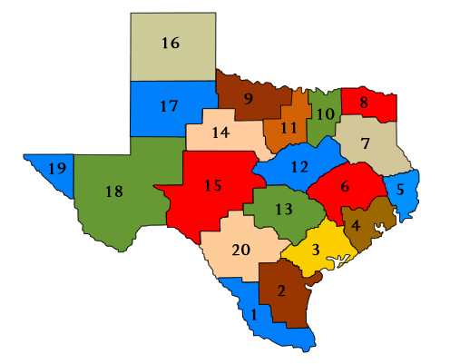
Next Steps For TEA and ESCs
Bringing About ESF Goals
Organizing and aligning
Common Language
Coordinated efforts
Notes:
Next steps:
TEA is working to organize the agency around these actions – common language, organizing our offerings/supports by practices
Working with our ESCs to determine where our supports are strong and for which actions are our supports scant

Slide 13
ESC ESF-Aligned Supports
Optional slide for ESC to drop in 2-3 bullets describing their ESF services (existing or in development)

Slide 14
Interested in learning more?
ESC 1, Edinburg – March 27-28, 2019
ESC 4, Houston – March 19-20, 2019
ESC 11, Ft. Worth – March 25-26, 2019
ESC 18, Midland – April 23-24, 2019
ESC 13, Austin – May 2-3, 2019
ESC 20, San Antonio- April 1-2, 2019
To register:
www.texasesf.org
or
Contact your local ESC
Notes:
If you are interested in learning more about the ESF or starting to engage with the ESF for your continuous improvement planning, please take advantage of the upcoming opportunities.

