Slide 1
4 Disciplines of Execution
Burleson ISD

Slide 2
Why change?
Student achievement data results for 2016-17
Research and experiences of the executive team
Our systems were perfectly aligned for the results we received. If we wanted better results, we needed a more narrow focus.

Slide 3
District Educational Improvement Committee (DEIC)
Met to review performance objectives & strategies (keep, combine, or discard)
DIP was detailed & prescriptive; hard to define the what much less the why.
‘Keep’ stack was the smallest.
We knew we needed to narrow our focus of planning and doing.

Slide 4
Annual Goal Setting—District Improvement Plan
To realize increases in student achievement and learning—
Narrowed the scope of our work & worked to bring greater focus to our academic targets
Objective: to become more effective and efficient

Slide 5
Goal Accomplishment
FranklinCovey Research
Number of Goals (in addition to the whirwind) | 2-3 | 4-10 | 11-20
Goals Achieved with Excellence | 2-3 | 1 | 0

Slide 6
Narrowing Our Focus Using 4DX
District Goal 1: Student Achievement
School Year | # of Performance Objectives | # of Strategies
2016-17 (before implementation of 4DX) | 8 | 81
2017-18 (Year 1 of 4DX) | 2 | 31
2018-19 (Year 2 of 4DX) | 1 | 17

Slide 7
Burleson ISD WIG
BISD student achievement and progress levels will increase by 5% in all tested content areas for all student groups.

Slide 8
The 4 Disciplines
Focus on the Wildly Important Goal (WIG)
Act on the Lead Measures
Keep a Compelling Scoreboard (electronic &/or physical)
Create a Cadence of Accountability
5 minute video overview: https://www.franklincovey.com/Solutions/Execution/4-disciplines.html

Slide 9
The How
Weekly WIG Sessions
Developing Lead Measures
Changes in adult behavior
What we can leverage and influence
Commitments to the lead measures
Scoreboards
https://4dxos.com/formslogin/login.aspx?ReturnUrl=%2fdefault.aspx

Slide 10
The When
Weekly--same time every week
Principals--each Monday morning through ZOOM app
Elementary @ 8:15
Middle @ 8:45
High @ 9:15
Principals report on last week’s commitments to the lead measures and make new commitments

Slide 11
4DXOS
https://4dxos.com/formslogin/login.aspx?ReturnUrl=%2fdefault.aspx

Slide 12
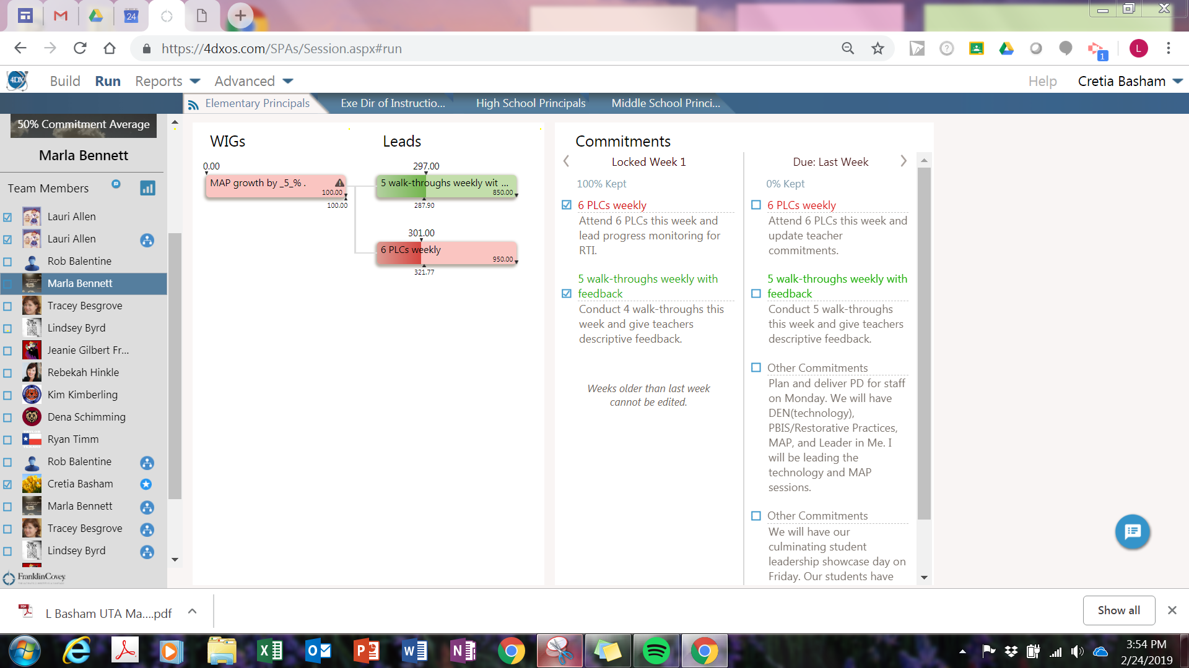

Slide 13
Results
We are seeing some improvement in reading scores but still not systemwide
Pockets of success on each campus
We are using MAP data as a Lead Measure
Winter results show declines in Math scores from 4th - 11th grades
We are staying the course and principals are using the data to guide their campus lead measures and commitments

Slide 14
Campus Perspective
Mrs. Marla Bennett

Slide 15
Academy of Leadership and Technology at Mound: Leader in Me School
Title One Campus, 50% ECD, Neighborhood Campus with School of Choice-3rd year (Leadership and Technology Focus)
Framework for Leader in Me: Leadership, Culture, and Academics
Year 1-Creating Culture, Focus on 7 Habits of Happy Kids, Modeled WIG at Campus Level, Teacher Lighthouse Team
Year 2- Aligning Academics-4 Disciplines of Execution, WIGS, Student Lighthouse Team Grades 3-5, Jan.2018 added Junior Lighthouse Team Grades K-2
Year 3-Empowering Instruction-added 2nd Student Led Conference in Fall

Slide 16
Academy of Leadership and Technology at Mound: Goal Achieving System/4DX
Discipline 1-Focus on the Wildly Important (WIG-X to Y by when)
Discipline 2-Act on the Lead Measures, Take the Key Steps
Discipline 3-Keep a Compelling Scoreboard-Keep Score
Discipline 4-Create a Cadence of Accountability (Collaborate/Huddle Up)
Notes:
School Academic WIG aligned to District WIG, Class WIGs aligned to school WIG-Vital goals that must be achieved to fulfill your school’s purpose and vision. 1-3 goals help us to keep focused.
Lead Measures are the leavers you use to achieve the WIG. Predictable and Influenceable.
Scoreboards-Results drive engagement. Goal and progress on lead measures.
Accountability-You are more likely to achieve a goal if you are accountable to someone. Make adjustments along the way

Slide 17
Academy of Leadership and Technology at Mound: Wildly Important Goals 2018-2019
WIG #1 Student growth scores will increase by 5% in reading for all students by May, 2019 as measured by MAP assessment.
WIG #2 100% of Academy of Leadership and Technology at Mound Elementary students will hold a Fall and Spring student-led parent conference by March 29, 2019.
WIG #3 100% of Academy of Leadership and Technology at Mound Elementary students will hold a leadership role.

Slide 18
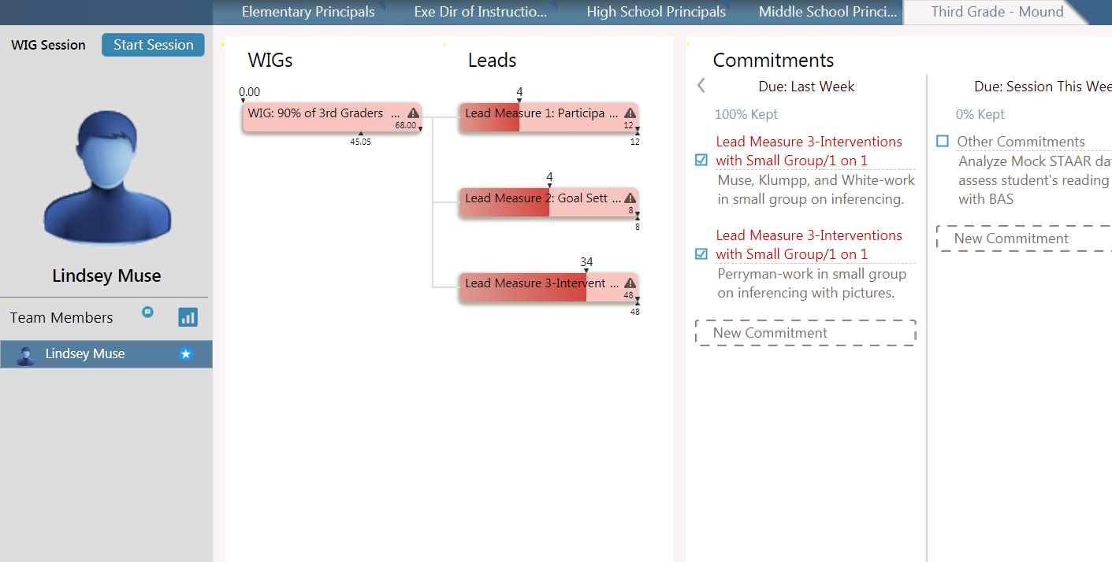

Slide 19
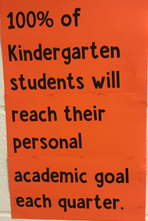
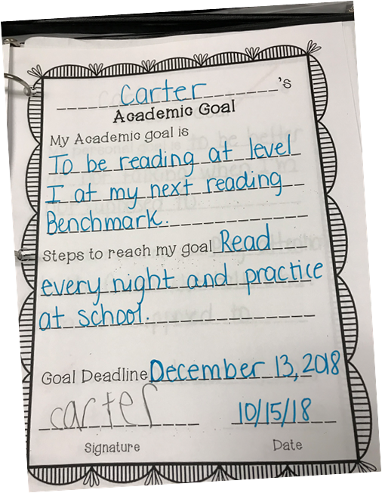
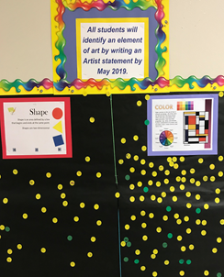
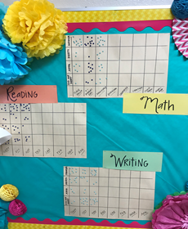
Academy of Leadership and Technology at Mound
Student Goal Setting, Class, and Grade Level Scoreboards

Slide 20
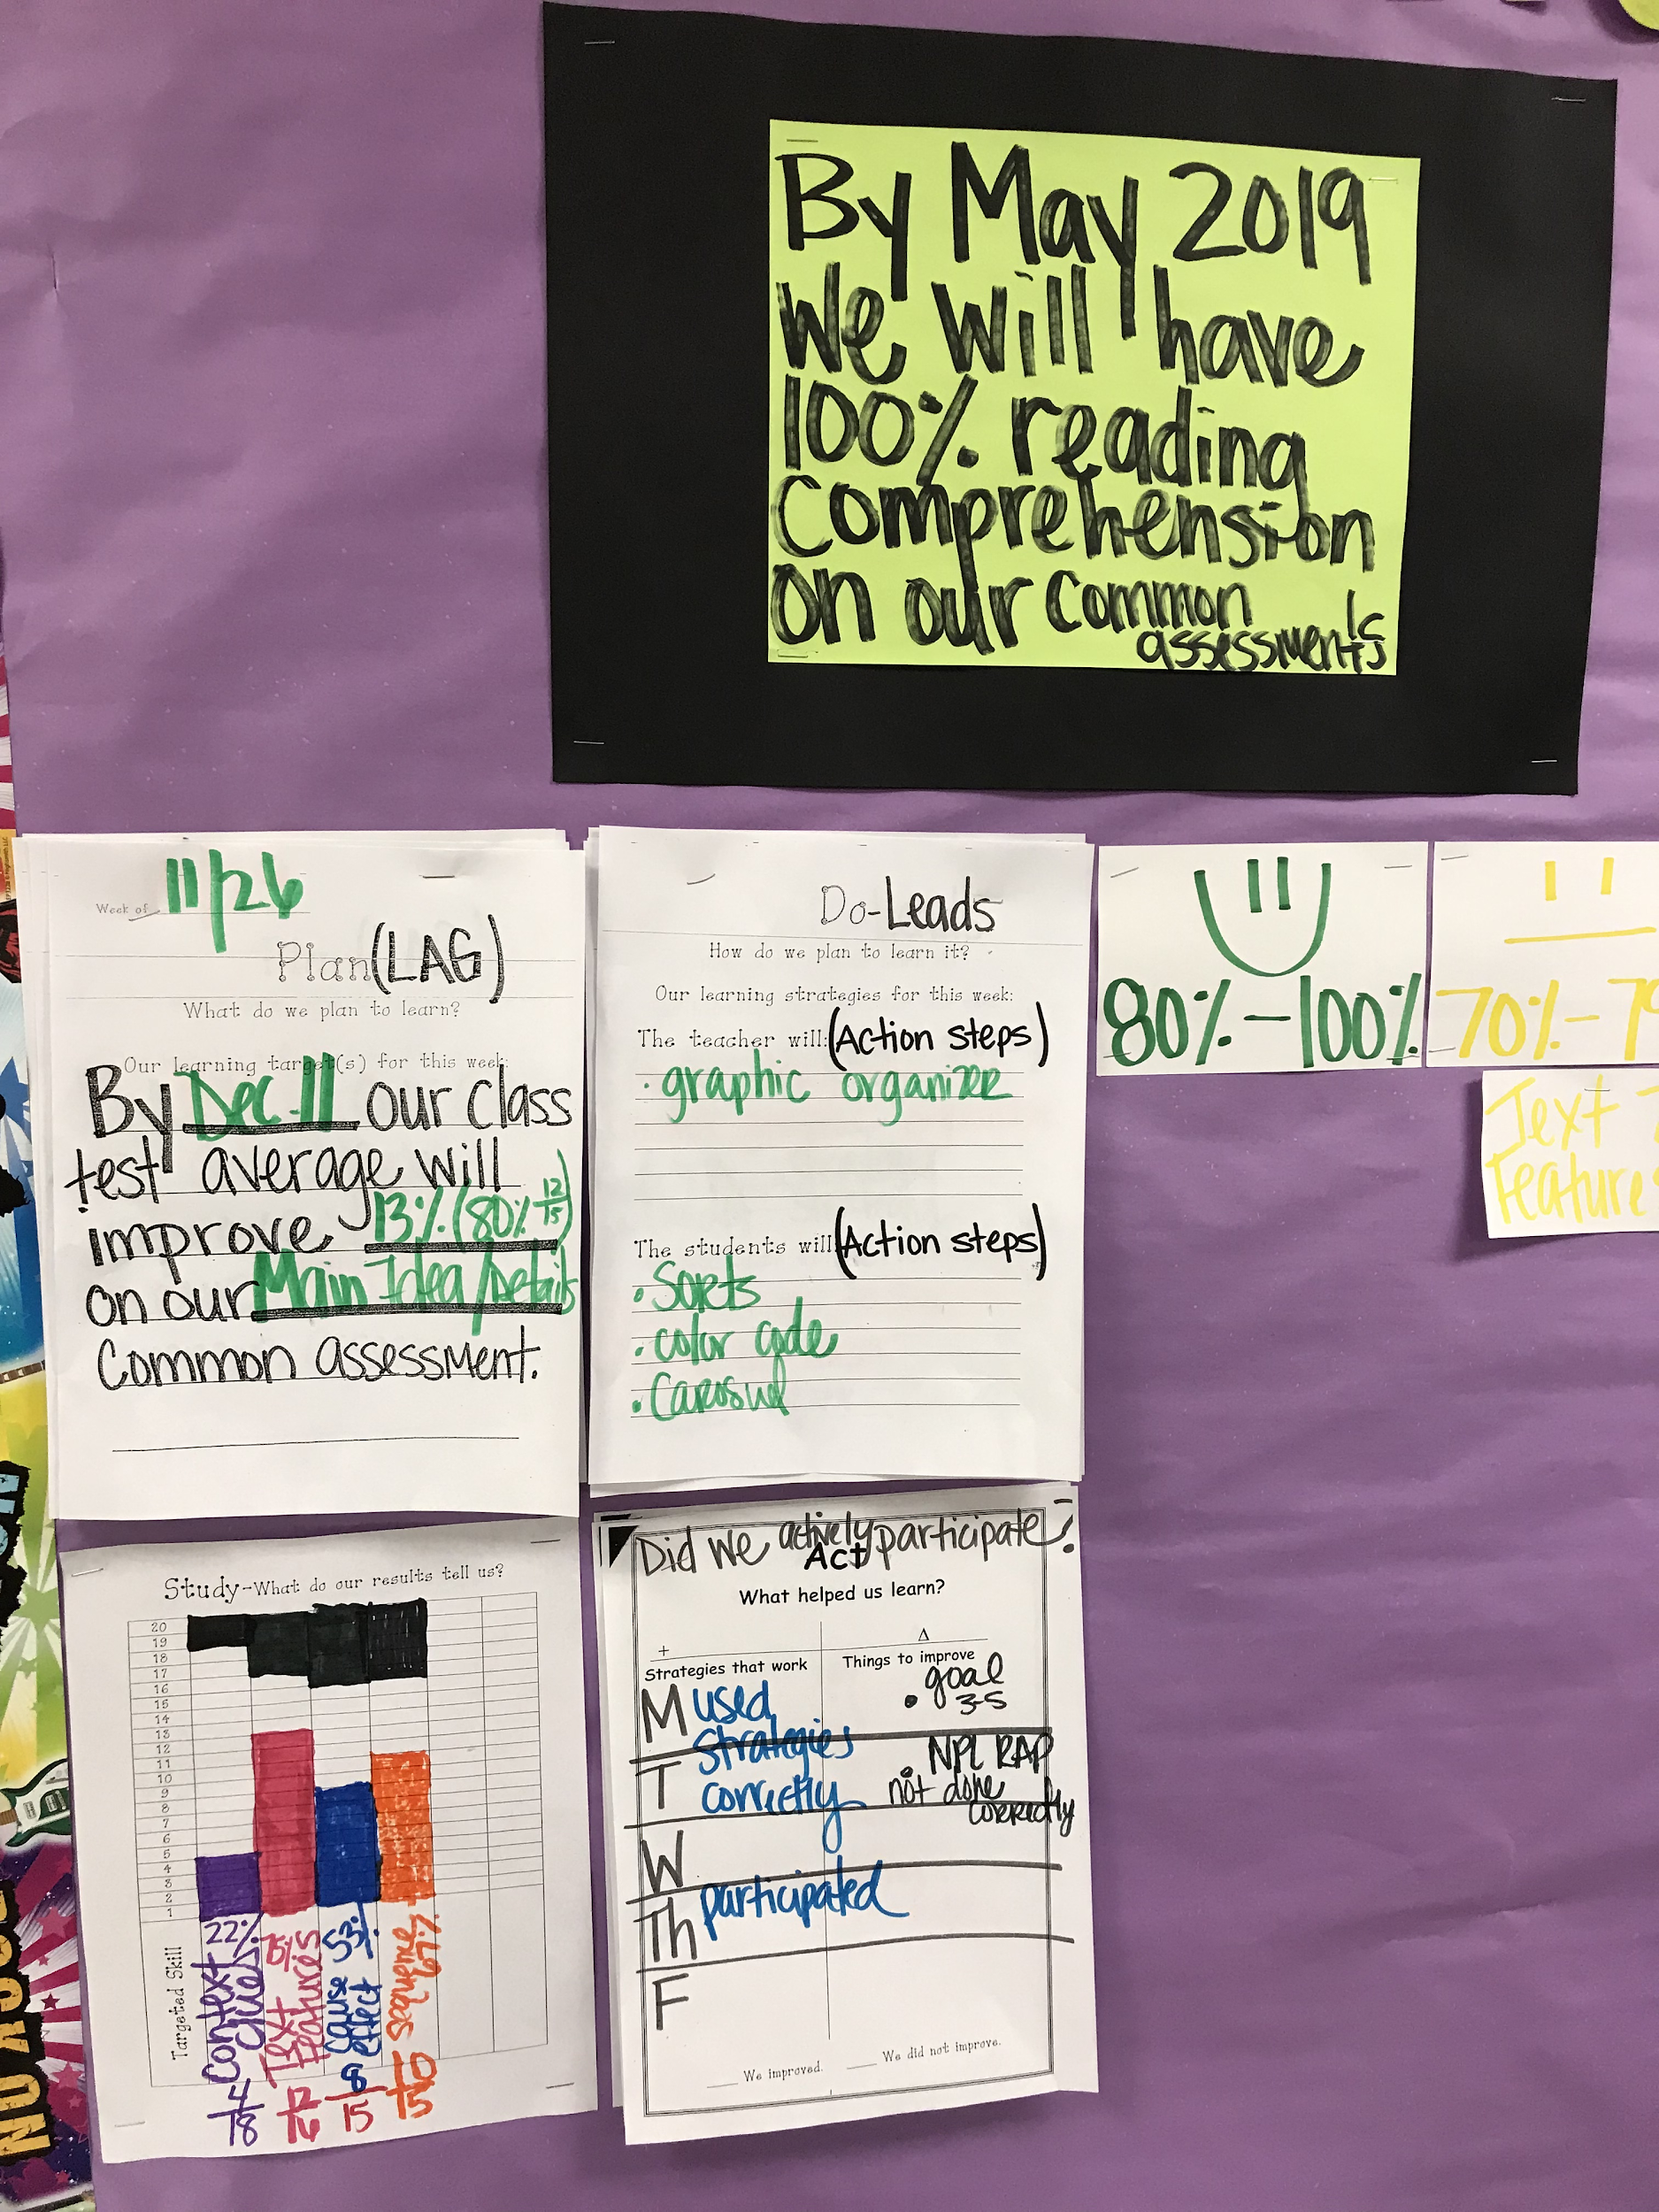
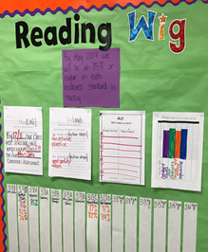
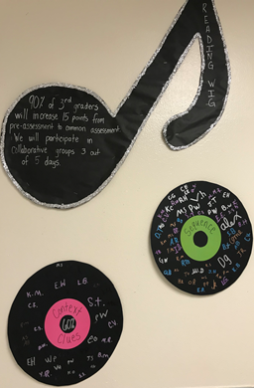
Academy of Leadership and Technology at Mound

Slide 21
Thank you!
Questions ?
cbasham@bisdmail.net
mbennett@bisdmail.net

