Slide 1
Cisco Academy courses cross walked with the Texas CTE clusters
IT Cluster
Networking Systems

Slide 2
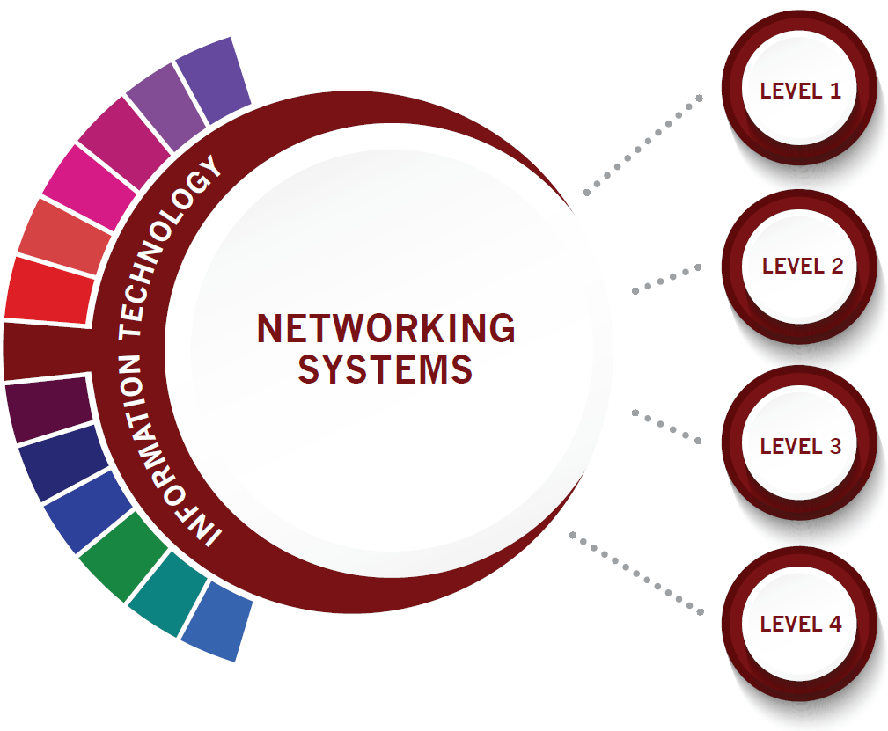
COURSES
Computer Science I
Python Essentials
Programming Essentials in C
Programming Essentials in C++
Principles of Information Technology
Principles of Cloud Computing (TBD)
Under development
Internetworking Technologies I
Introduction to Networking (CCNA 1)
Computer Maintenance/Lab
IT Essentials
AP Computer Science Principles
Advanced Programming in C++
Cloud Networking (TBD)
Internetworking Technologies II
Switching, Routing, and Wireless Essentials (CCNA 2)
Networking/Lab
Enterprise Networking, Security, and Automation (CCNA 3)
State course in bold
Cisco Academy resource italics, brown
Practicum in Information Technology
Enterprise Networking, Security, and Automation (CCNA 3)
Practicum in Entrepreneurship (TBD)
Project Based Research
Career Preparation I

Slide 3
Networking Systems
State course in bold
Cisco Academy resource italics, brown
LEVEL 1
Computer Science I
Programming Essentials In Python
70 hours
PCAP – Certified Associate in Python Programming
Programming Essentials in C
70 hours
C Programming Language Certified Associate Certification (CLA)
Programming Essentials in C++
70 hours
C++ Certified Associate Programmer Certification (CPA)
Part 1 of 2 needed for C++ Certified Professional Programmer Certification (CPP)
Principles of Information Technology
Principles of Cloud Computing (TBD)
Under development

Slide 4
Networking Systems
LEVEL 2
Internetworking Technologies I
Introduction to Networking (CCNA 1)
70 hours
Networking Academy badge
Cisco Certified Technician Routing and Switching – CCT-RSTech
Computer Maintenance/Lab
IT Essentials
70 hours
CompTIA A+ Certification
AP Computer Science Principles
Advanced Programming in C++
70 hours
C++ Certified Professional Programmer Certification (CPP)
Cloud Networking (TBD)
State course in bold
Cisco Academy resource italics, brown

Slide 5
Networking Systems
LEVEL 3
Internetworking Technologies II
Switching, Routing, and Wireless Essentials (CCNA 2)
70 hours
Networking Academy badge
Networking/Lab
Enterprise Networking, Security, and Automation (CCNA 3)
70 hours
Networking Academy badge
CCNA: Switching, Routing, and Wireless Essentials
State course in bold
Cisco Academy resource italics, brown

Slide 6
Networking Systems
LEVEL 4
Practicum in Information Technology
Could use ENSA course here instead of above (3rd CCNA course)
Practicum in Entrepreneurship (TBD)
Project Based Research
Career Preparation I

Slide 7
Cisco Academy courses cross walked with the Texas CTE clusters
STEM Cluster
Cybersecurity

Slide 8
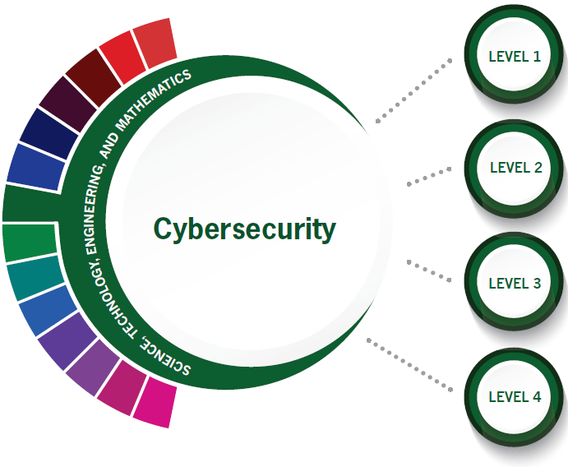
COURSES
Principles of Information Technology
Fundamentals of Computer Science
Programming Essentials in C
Foundations of Cybersecurity
Introduction to Cybersecurity
Cybersecurity Essentials
Linux Essentials
Internetworking Technologies I
Introduction to Networking (CCNA 1)
Computer Programming I
Programming Essentials in C++
Computer Science I
Programming Essentials in Python
AP Computer Science Principles
Computer Maintenance/Lab
IT Essentials
Internetworking Technologies II
Switching, Routing, and Wireless Essentials (CCNA 2)
Engineering Applications of Computer Science Principles
Networking/Lab
Enterprise Networking, Security, and Automation (CCNA 3)
Digital Forensics
AP Computer Science
Advanced Programming in C
Advanced Programming in C++
State course in bold
Cisco Academy resource italics, green
Cybersecurity Capstone
CCNA CyberOps Associate
Practicum in Information Technology
Practicum in STEM
Project-Based Research

Slide 9
Cybersecurity
LEVEL 1
Principles of Information Technology
Fundamentals of Computer Science
Programming Essentials in C
70 hours
C Programming Language Certified Associate Certification (CLA)
Foundations of Cybersecurity
Introduction to Cybersecurity
15 hours
Networking Academy badge
Cybersecurity Essentials
30 hours
Linux Essentials
70 hours
LPI Linux Essentials Professional Development Certificate (PDC)
State course in bold
Cisco Academy resource italics, brown

Slide 10
Cybersecurity
State course in bold
Cisco Academy resource italics, brown
LEVEL 2
Internetworking Technologies I
Introduction to Networking (CCNA 1)
70 hours
Networking Academy badge
Cisco Certified Technician Routing and Switching – CCT-RSTech
Computer Programming I
Programming Essentials in C++
70 hours
C++ Certified Associate Programmer Certification (CPA)
Part 1 of 2 needed for C++ Certified Professional Programmer Certification (CPP)
Computer Science I
Programming Essentials In Python
70 hours
PCAP – Certified Associate in Python Programming
AP Computer Science Principles
Computer Maintenance/Lab
IT Essentials
70 hours
CompTIA A+ Certification

Slide 11
Cybersecurity
LEVEL 3
Internetworking Technologies II
Switching, Routing, and Wireless Essentials (CCNA 2)
70 hours
Networking Academy badge
Engineering Applications of Computer Science Principles
Networking/Lab
Enterprise Networking, Security, and Automation (CCNA 3)
70 hours
Networking Academy badge
CCNA: Switching, Routing, and Wireless Essentials
Digital Forensics
AP Computer Science
Advanced Programming in C
70 hours
CLP – C Certified Professional Programmer Certification
Advanced Programming in C++
70 hours
C++ Certified Professional Programmer Certification (CPP)
State course in bold
Cisco Academy resource italics, brown

Slide 12
Cybersecurity
LEVEL 4
Cybersecurity Capstone
CCCNA CyberOps Associate
70 hours
CyberOps Associate certification
Practicum in Information Technology
Practicum in STEM
Project-Based Research

